Slide 1

RAG-based Chatbot for Mobica Factories Catalog
This presentation explores a RAG-based chatbot for the Mobica Factories catalog, demonstrating how advanced retrieval techniques enhance sales support and streamline information access.

Slide 2
Agenda
1
Project Overview
2
Problem Statement & Motivation
3
Technical Architecture & Key Technologies
4
System Workflow & Demo Walkthrough
5
Business Impact & Future Enhancements
6
Q&A / Conclusion

Slide 3
Problem Statement & Motivation
Challenges
Motivation
Customers and sales teams need quick, detailed product information. Manual lookups in large catalogs are time-consuming and error-prone. Language barriers can hinder communication in a diverse market.
To build a system that instantly retrieves and delivers precise product details. To support both English and Arabic, ensuring accessibility for a broader audience.

Slide 4

Project Overview
What It Does
Key Benefits
Acts as a sales assistant chatbot for Mobica Factories. Uses RAG to extract contextually relevant information from a PDF catalog. Supports bilingual interactions (English and Arabic).
Instant access to detailed product specifications. Enhances sales team efficiency and customer satisfaction. Streamlines the decision-making process during sales interactions.

Slide 5
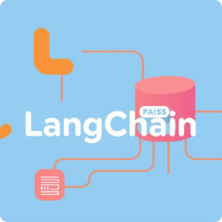


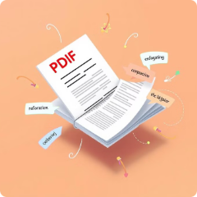
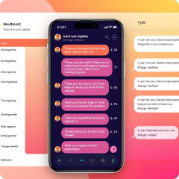
Technology Stack & Innovations
LangChain & FAISS
Ollama Embeddings & LLM
Caching Mechanisms
Conversational retrieval orchestration and efficient vector search.
Natural language understanding and precise answer generation.
Enhanced performance through pre-processed documents and vector stores.
Semantic Chunking
Streamlit
Improved retrieval accuracy via meaningful PDF catalog segments.
Responsive, interactive chatbot interface.

Slide 6
System Architecture & Workflow
Document Processing
Load the Mobica catalog PDF using PDFPlumber. Apply Semantic Chunking to create context-rich segments.
Conversational Chain
Use a custom prompt template to guide the LLM for context-based responses.
1
2
3
4
Vector Store Creation
Multilingual Support
Generate embeddings and store them in FAISS for rapid retrieval.
Automatically detect query language and respond in English or Arabic.

Slide 7
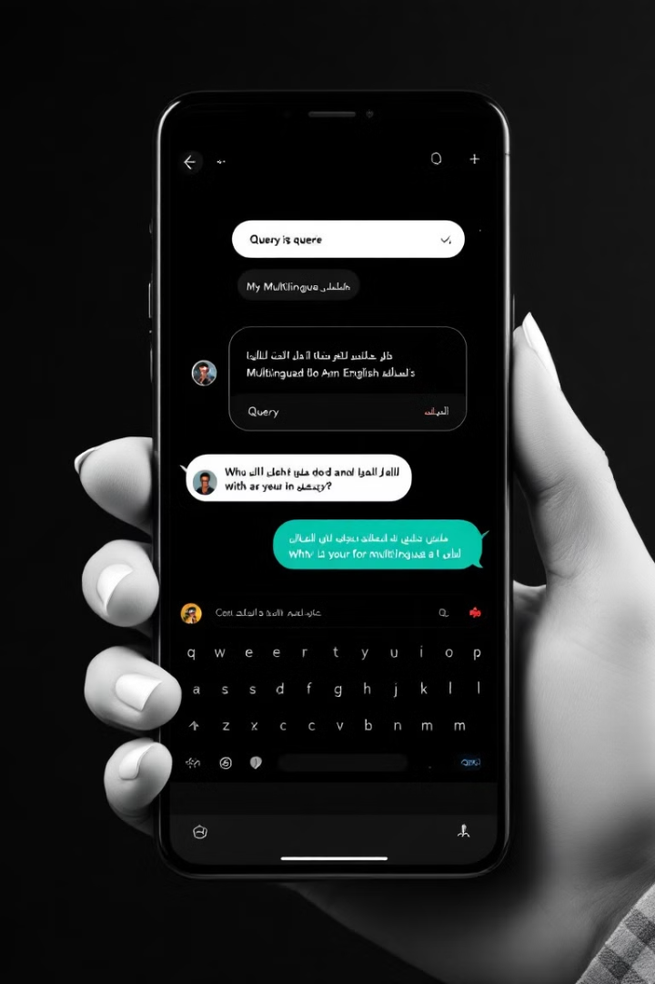
Demo Walkthrough
Interface Overview
Interactive Streamlit-based chat interface.
Use Cases
Querying product details (e.g., specifications of the REGAL desk). Demonstrating multilingual support with both English and Arabic queries.
Highlights
Speed and accuracy of data retrieval. Seamless transition between languages based on user input.

Slide 8



Business Impact & Future Enhancements
Current Impact
Future Enhancements
Accelerates the sales process by providing instant, accurate product information. Enhances customer satisfaction and supports informed decision-making.
Integrate real-time inventory and pricing data. Expand the system to cover additional product lines. Further refine the UI for an even more engaging user experience.

